Slide 1
Rational functions
Asymptotes and graphs

Slide 2
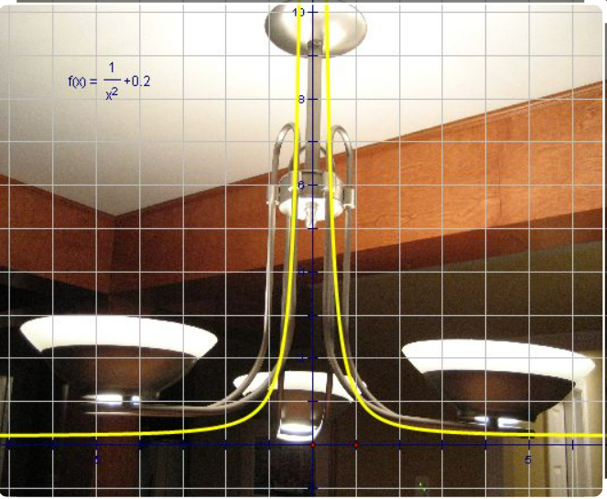

Rational function

Slide 3

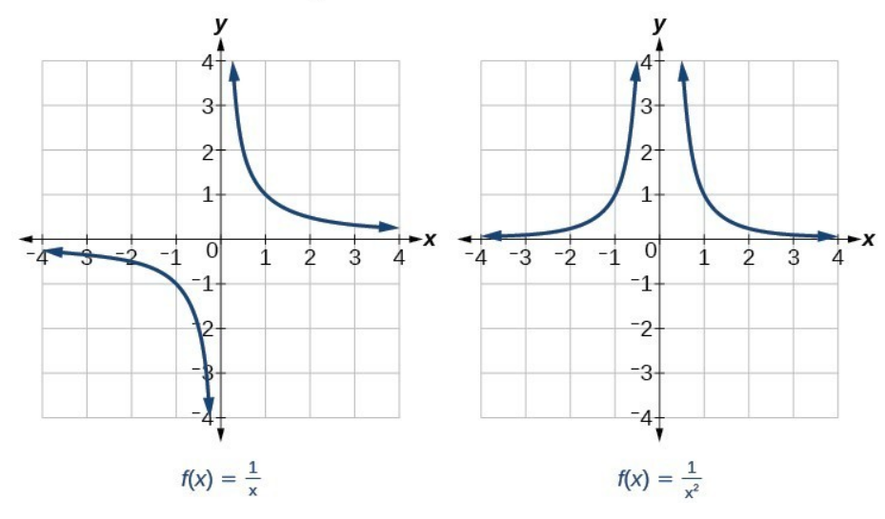

Slide 4
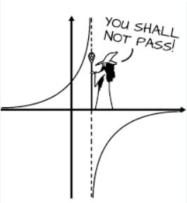

asymptotes
There are two types of Asymptotes:
Vertical asymptotes
Horizontal asymptotes

Slide 5


Vertical asymptotes

Slide 6

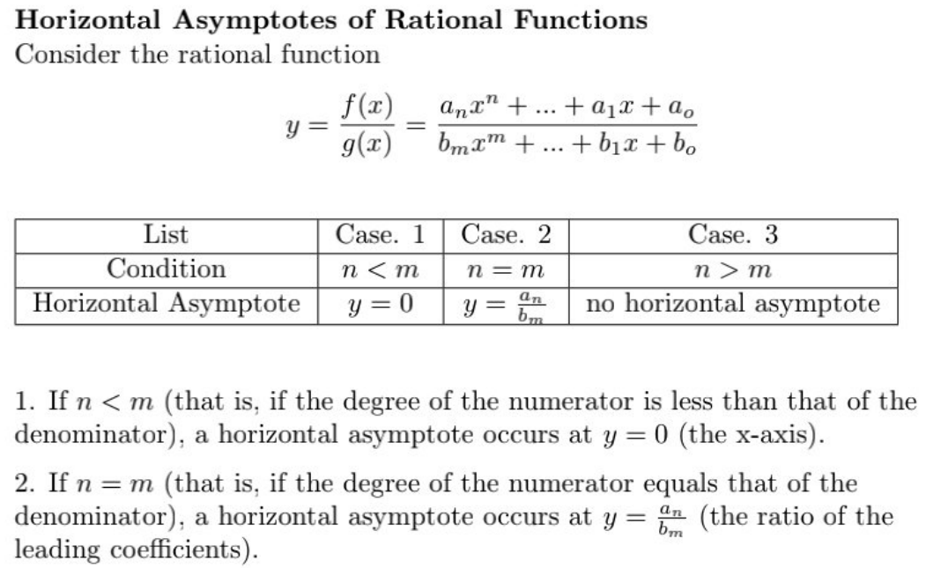
Horizontal asymptotes

Slide 7
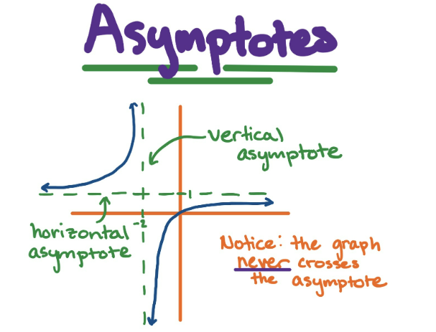

Slide 8


Example

Slide 9

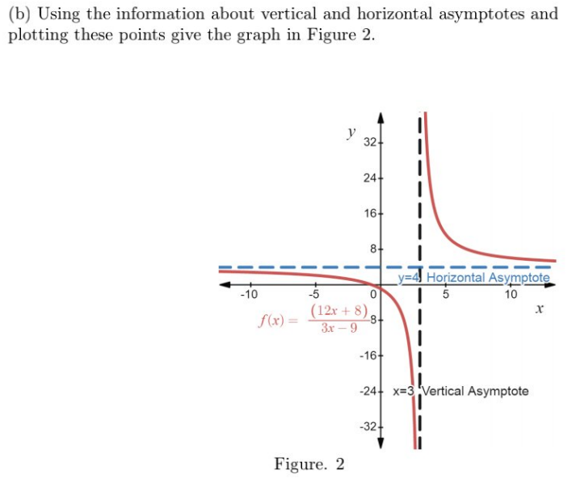

Slide 10
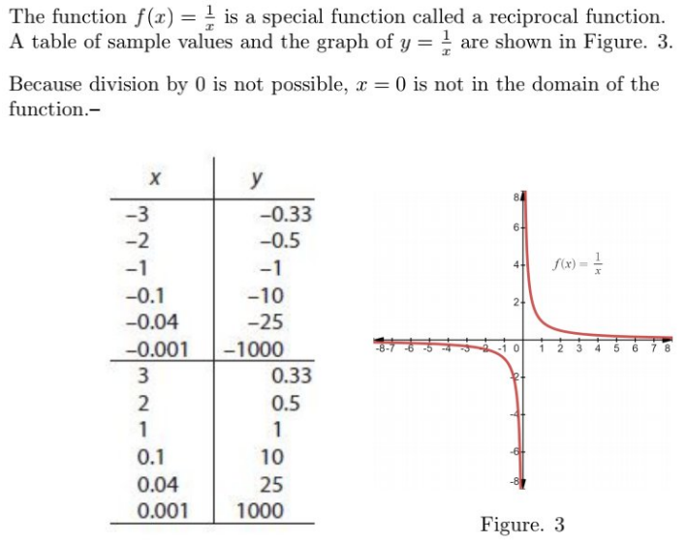
Example 2

Slide 11
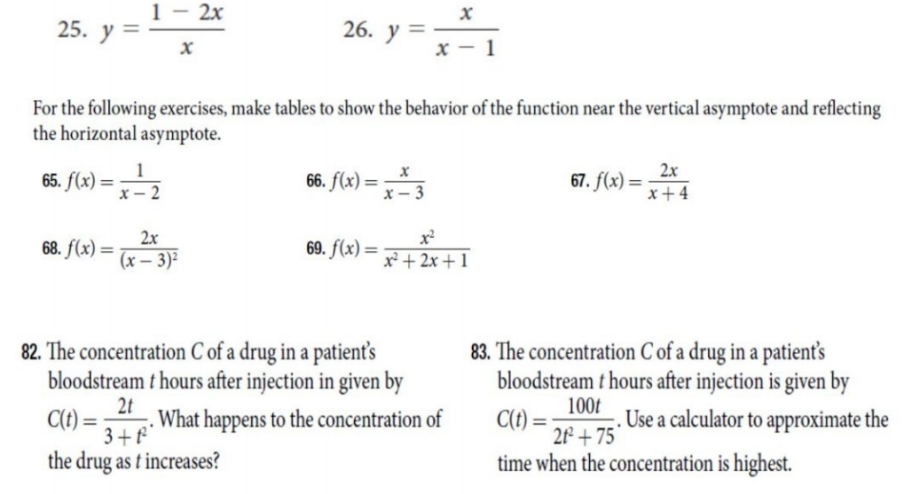
Exercise

